Slide 1
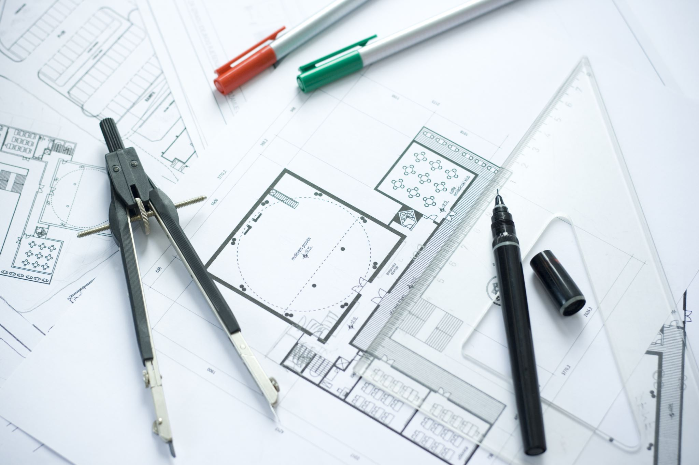
Workplace Project Breaking Down Silos: Developing a Knowledge Sharing Platform for Internal Business
Callum White - N0900053
Notes:
Hello and welcome to my presentation about my workplace project.

Slide 2

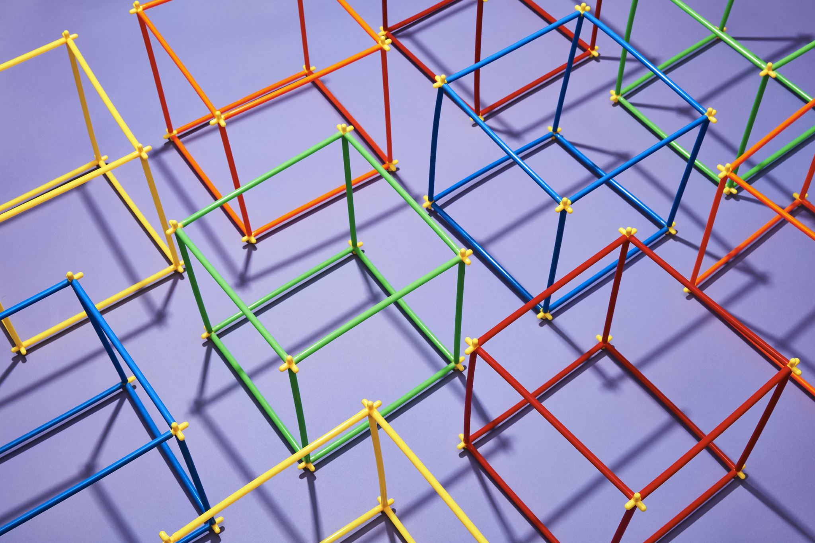
Introduction
Layout:
Benefits of knowledge sharing platform
What currently in the market?
Key features and functionalities
Project outline
Steps to implementation
Best practices and lessons learned
Notes:
Welcome, everyone, to today's presentation on developing a knowledge sharing platform for internal business. In today's fast-paced and rapidly changing business environment, it's more important than ever to break down silos and promote collaboration across teams and departments. By doing so, we can leverage the diverse skills, knowledge, and experience of our employees to drive innovation, solve complex problems, and achieve our business goals.
A knowledge sharing platform can be a powerful tool to facilitate this collaboration and promote the free flow of information and ideas across our organization. In this presentation, we will explore the benefits of developing a knowledge sharing platform, the key features and functionalities to consider, and the steps involved in implementing such a platform. We will also discuss some best practices and lessons learned from other organizations that have successfully implemented knowledge sharing platforms.
Thank you for joining us today, and we hope you find this presentation informative and valuable.

Slide 3

Silos and ad-hoc sharing methods are causing issues in the business
Notes:
Our business has separate departments that work in silos, leading to communication barriers and duplication of effort.
Departments often rely on ad-hoc sharing methods like email and messaging, which are informal and can result in useful findings being excluded from certain teams.
This lack of collaboration and information sharing can result in missed opportunities, slower decision-making, and decreased innovation.
Developing a knowledge sharing platform can help us break down these silos and promote better collaboration, allowing us to leverage the diverse skills and expertise of our employees to drive innovation and achieve our business goals.

Slide 4
Opportunity
Way to share knowledge between departments
Reduced duplication of effort
Reduction of silos
of department
Increased collaboration
Notes:
The opportunity to bring in a revolutionary way to share knowledge between departments would be a huge asset to the business. Initial improvements would be seen in the reduced duplication of effort, and as time advances it would encourage the reduction of silos by increased collaboration, sharing of knowledge, and between department idea generation.

Slide 5
Knowledge Sharing Platform for Collaborative Research
Enables real-time communication and knowledge sharing among departments
Reduces duplication of effort and exclusion of departments from useful findings
Departments involved: Product Design, UX, Research, Marketing
Items shared: links, papers, books, videos, summaries, analysis
Current ad-hoc sharing methods: email, Teams, SharePoint, OneDrive, People First communities, Miro
Notes:
Enabling real-time communication and knowledge sharing among departments can help to break down silos and promote better collaboration, leading to increased innovation and efficiency.
A knowledge sharing platform can reduce duplication of effort and help to ensure that all departments have access to useful findings, regardless of their level of involvement in the original research or discovery.
Several departments are involved in the knowledge sharing process, including Product Design, UX, Research, and Marketing, highlighting the cross-functional nature of this initiative.
The types of items shared through the knowledge sharing platform include links, papers, books, videos, summaries, and analysis, representing a diverse range of knowledge sources and formats.
Current ad-hoc sharing methods like email, Teams, SharePoint, OneDrive, People First communities, and Miro can be helpful, but they are not ideal for ensuring that all departments have access to the same information in a timely and efficient manner. A knowledge sharing platform can help to streamline this process and ensure that knowledge is shared more equitably and effectively.

Slide 6
Gap Analysis
Current State | Desired State | Action to state
Content is currently shared between departments on an ad-hoc, informal basis, which can lead to duplication of effort or (unintended) exclusion of departments from useful findings. | An application for departments to manage and tag content. | Develop a cloud application where departments can share and tag content for other departments in a social feed.
Presently there is no access to globally search across the business for knowledge content, which causes an increase in time due to not knowing content location. | Simplistic searching of content to allow users to use subjects. | Tagging of content and provide search functionally to filter down content.
Content has no managed structure, and data is shared in different formats, making it difficult to analyse and report on. | Provide basic content structure and types to allow for manageable knowledge resources. | The system should allow users to enter content via forms which has strict content types, links, word documents, images, etc.
Content shared around the business has no feedback feed for employees to share thoughts on the knowledge resources. | Have collaborative feedback feature to allow for employees to feedback. | Have comments to be posted on the content for the author to review and reply.
Notes:
MHR has multiple departments who participate in research, as part of their job role, to keep up with changing trends in the sector of Human Resources (HR), payroll, technology, and other related topics.
Items are often shared between departments on an ad-hoc, informal basis, which can lead to duplication of effort or (unintended) exclusion of departments from useful findings.

Slide 7

Systems study

Slide 8
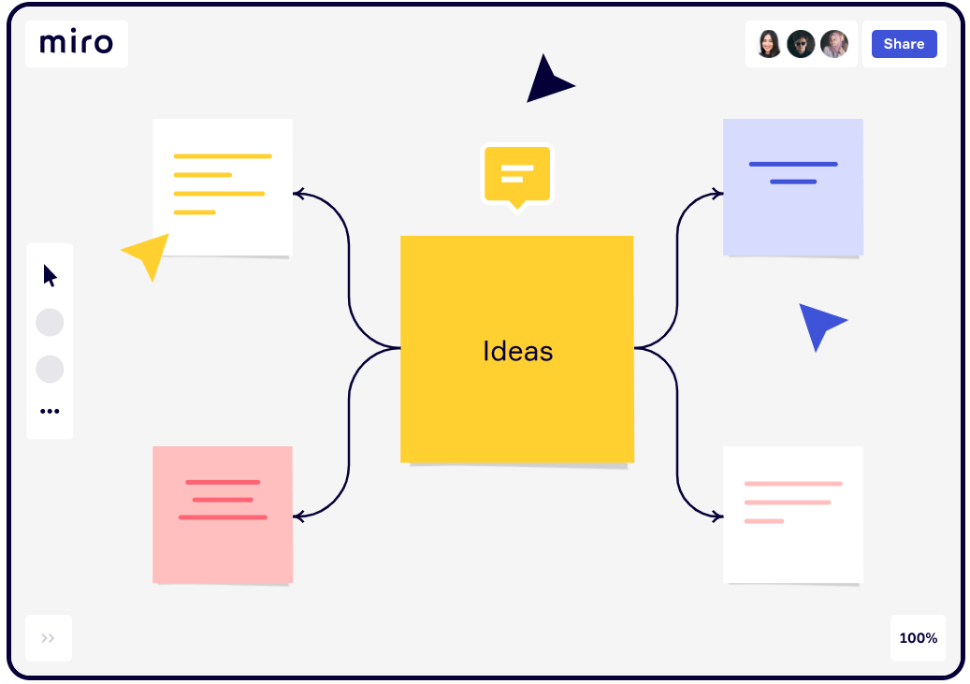
Miro board
Positions itself as a collaborative digital whiteboard that is simple to use. You can arrange objects, make notes, and connect via online chat or embedded videocalls all within the software.
(Innovation training (2021))

Slide 9
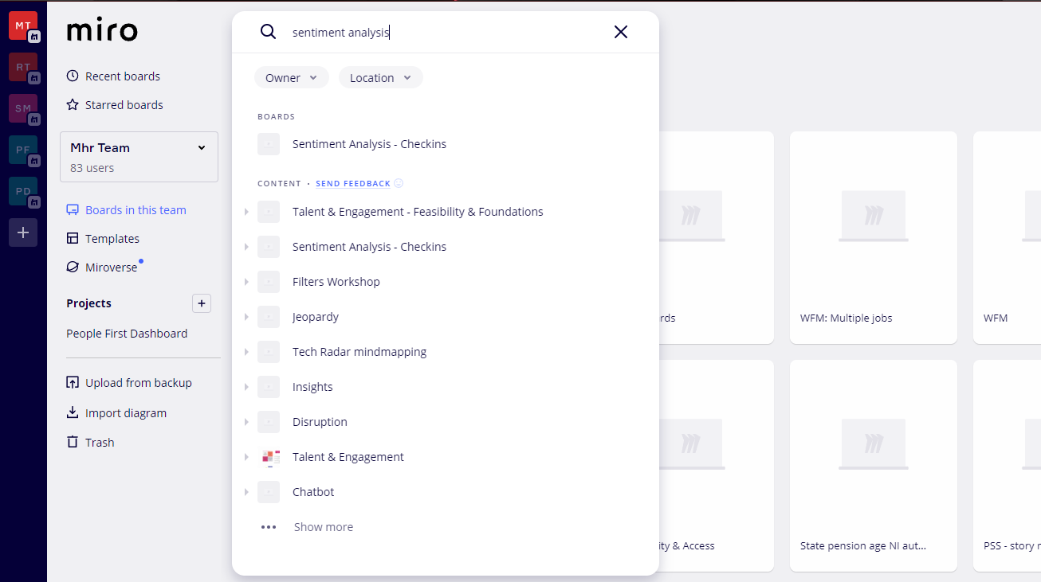
Miro board limitations
External tool – separate to MHR’s infrastructure
Very much a whiteboard online – so they can get unwieldy and hard to go back to
Search multiple boards is limited

Slide 10

Live demo of Miro board
Live demo of Miro board within MHR

Slide 11
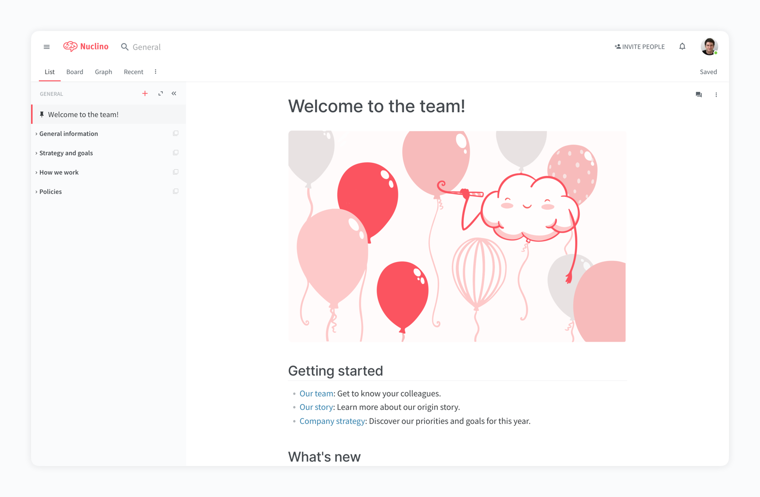
Nuclino
Teams may share and edit documents in real-time with the aid of the knowledge management and collaboration platform Nuclino. Furthermore, the effective search function rapidly displays pertinent results, and the phrases are highlighted in the results, making it simpler to locate desired information (Hero, 2021).
(Marketing tools you can use 2022 (2022))

Slide 12
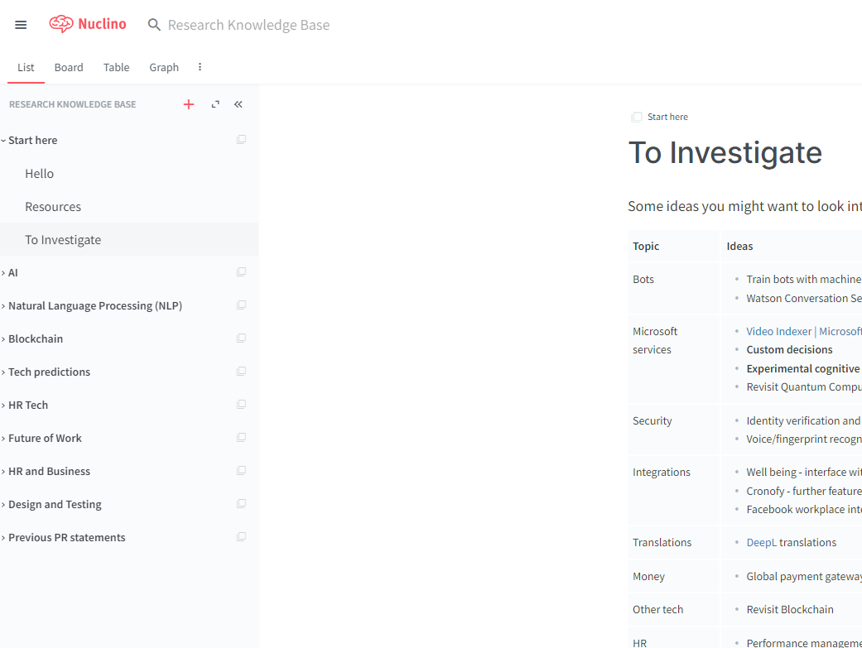
Nuclino limitations
Completely new tool, separate to MHR’s infrastructure.
Content hosted outside of MHR datacentre.
High price for budget

Slide 13
Results of analysis
Keep the system within MHRs cohesive infrastructure
01
Flexible data structure and searching
02
Within MHRs datacentre
03
Content templating
04

Slide 14
Gap in existing solutions
Existing solutions lack effective search capabilities, resulting in irrelevant keyword-based searches.
This market gap offers an opportunity for knowledge-sharing platforms with graph databases and tagging techniques.
Graph databases enable complex data relationships, suggesting relevant information.
Tagging improves search results, enhances knowledge organization, and supports decision-making.
Notes:
Existing solutions for knowledge repositories often fail to provide effective search capabilities. Keyword-based searches may not always yield relevant results, leaving a gap in the market. Knowledge-sharing platforms that leverage graph databases and tagging techniques can fill this gap and enhance productivity. Graph databases enable complex relationships between data points, allowing the platform to suggest relevant information based on these connections. Additionally, tagging enhances search results by providing more precise categorization of information. Incorporating these features, knowledge-sharing platforms can better support knowledge management and decision-making processes. In summary, the lack of effective search tools in current solutions creates a market opportunity for knowledge-sharing platforms. By utilizing graph databases and tagging techniques, these platforms can improve search effectiveness, facilitate knowledge organization, and enhance decision-making.

Slide 15
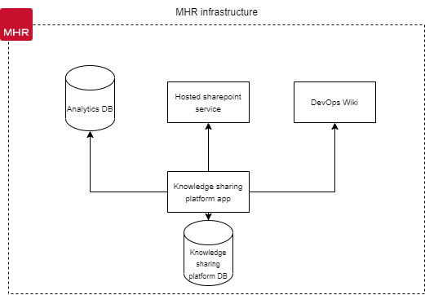
Proposal
The new system will be built in-house, ensuring control over the solution's requirements and features.
Building the system internally enables cohesive services for employees to utilize.
The system will provide a cloud application for employees to manage, tag, and search for content.
Notes:
This new system will be built inhouse, allowing for controlled outcomes of the solution’s requirements and features. This will also enable cohesive services for employees to use and provide a cloud application allowing employees to manage, tag, and search for content.

Slide 16
Challenges
People don’t share new knowledge: The repository needs to be added to regularly to ensure knowledge doesn’t stay in personal notes, OneDrive documents or within teams, therefore it needs to be accessible and easy to use.
People can’t find knowledge: The tool needs to have a good mechanism for searching so that discoverability of current knowledge is easy.
Knowledge needs to stay in-house: The tool needs to have secure access for MHR internal employees only (e.g. use of single sign on).
People will want the solution to fulfil other requirements: When creating the solution, ensure that it doesn’t try to fulfil too wide a scope – first and foremost it is an easy-to-use repository of knowledge for MHR.
Notes:
People don’t share new knowledge: The repository needs to be added to regularly to ensure knowledge doesn’t stay in personal notes, OneDrive documents or within teams, therefore it needs to be accessible and easy to use.
People can’t find knowledge: The tool needs to have a good mechanism for searching so that discoverability of current knowledge is easy.
Knowledge needs to stay in-house: The tool needs to have secure access for MHR internal employees only (e.g. use of single sign on).
People will want the solution to fulfil other requirements: When creating the solution, ensure that it doesn’t try to fulfil too wide a scope – first and foremost it is an easy-to-use repository of knowledge for MHR.

Slide 17
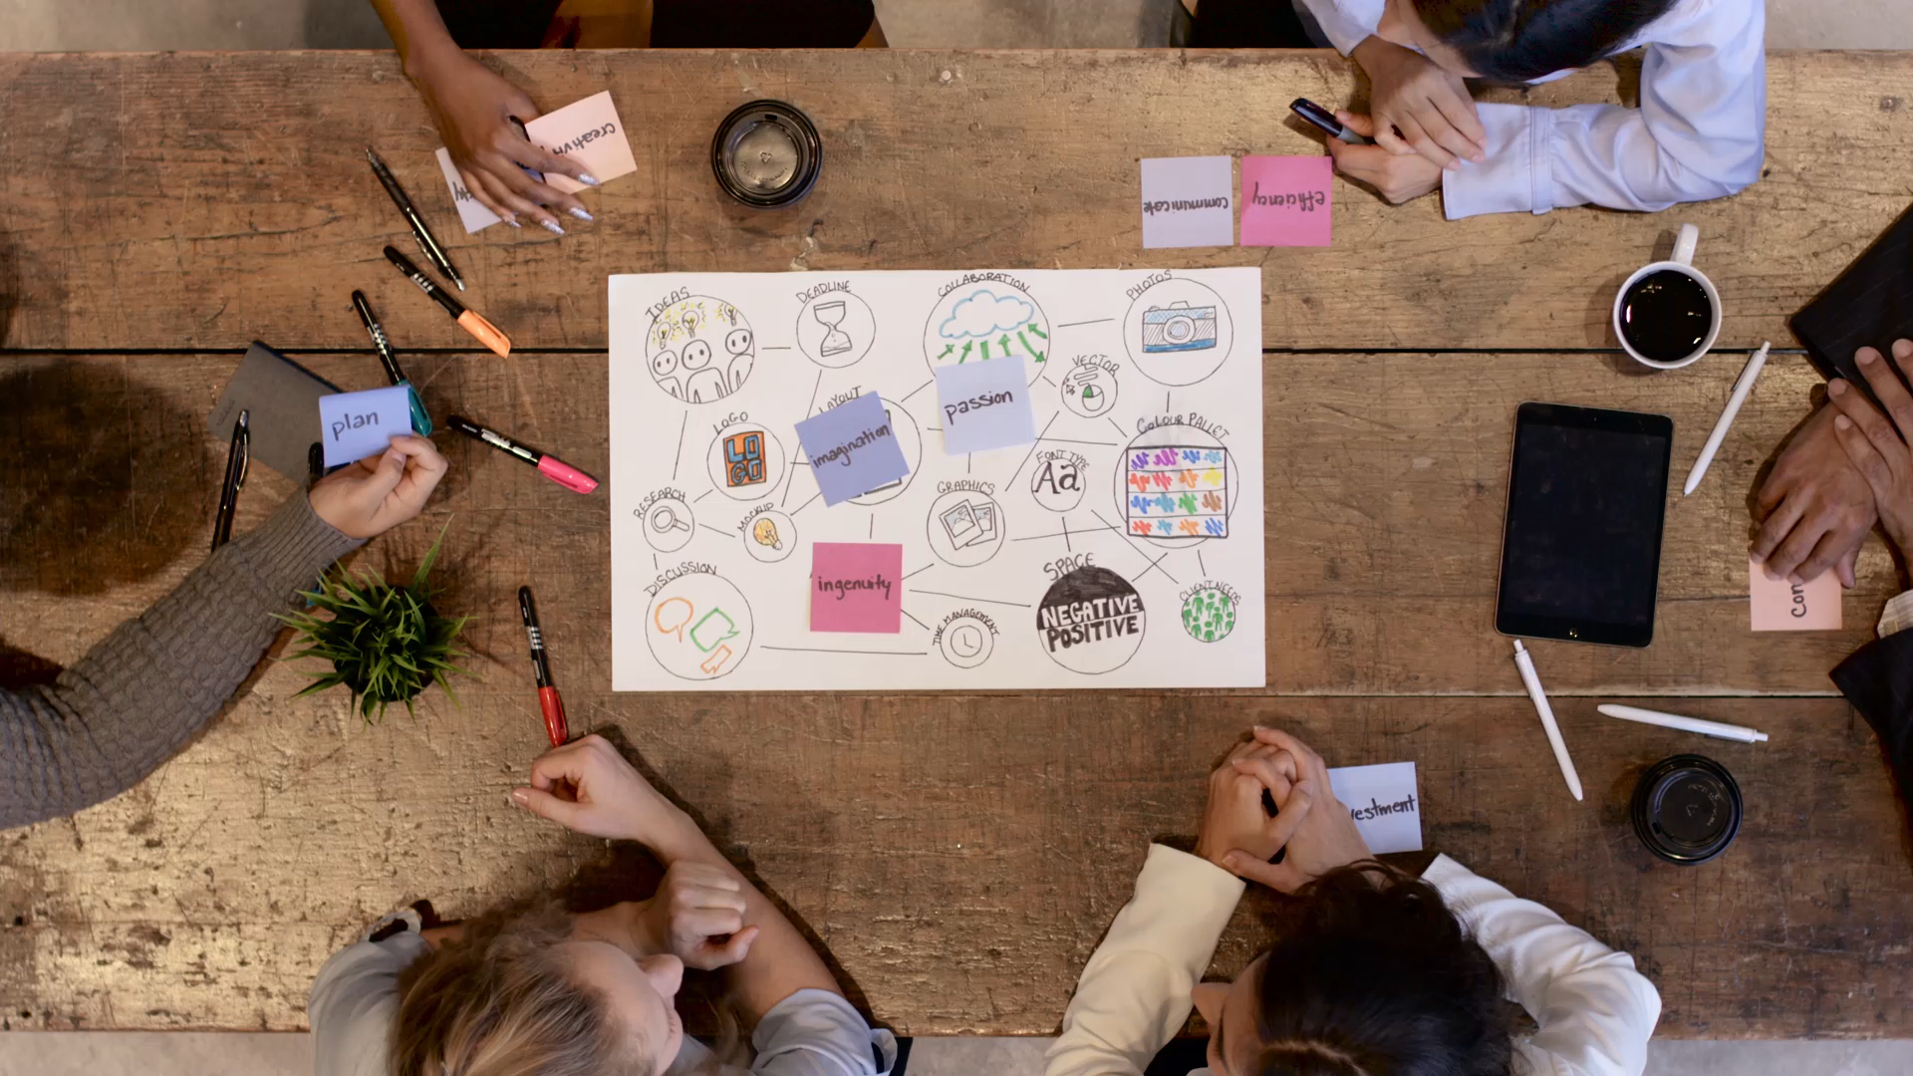
Project scope
Phase 1
Cloud-based central knowledge platform.
The central repository will allow users to manage, feedback and share content between employees of MHR.
Provide simplistic searching capabilities with content templating.

Slide 18
Project timeline
Development completed
Publish to userbase
Jan 2023
Analysis/Software Requirements
Feb 2023
Foundation scope 1
DevOps & Environment Development Setup
March 2023
Development -
Timebox 1 & 2 begins
April 2023
Development – Timebox 1 & 2 completed
May/June 2023
Timebox 3 begins

Slide 19
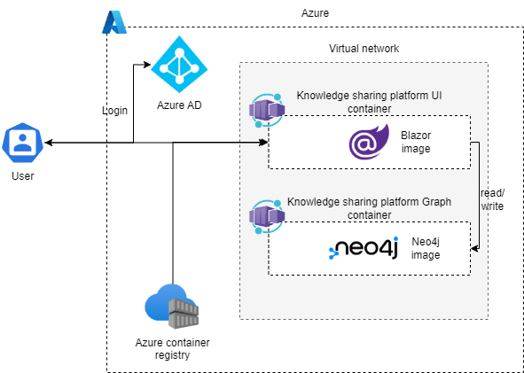
Architecture Diagram
Using Azure as the cloud provider.
Azure AD for SSO
Azure container registries for

Slide 20
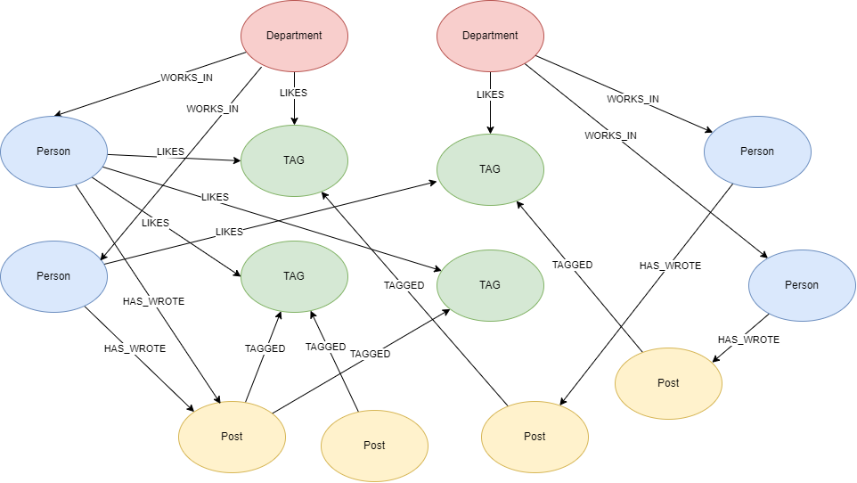
Graph database design
Department
name: a string representing the name of the department.
description: a string representing a description of the department.
location: a string representing the location of the department.
Person
name: a string representing the name of the person.
age: an integer representing the age of the person.
email: a string representing the email address of the person.
Post
title: a string representing the title of the post.
body: a string representing the body of the post.
timestamp: a datetime object representing the time when the post was created.
type: a string which represents the type of post.
Tag
name: a string representing the name of the tag.
description: a string representing a description of the tag.

Slide 21
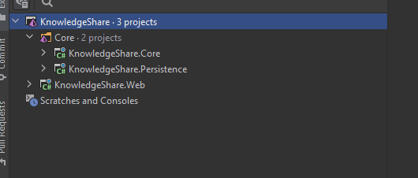

.NET Application setup
Layered architecture
Notes:
Creating a .NET project with a layered architecture consisting of KnowledgeShare.Web, KnowledgeShare.Core, and KnowledgeShare.Persistence is a good design because it promotes separation of concerns, improves maintainability, and enhances testability of the application.

Slide 22
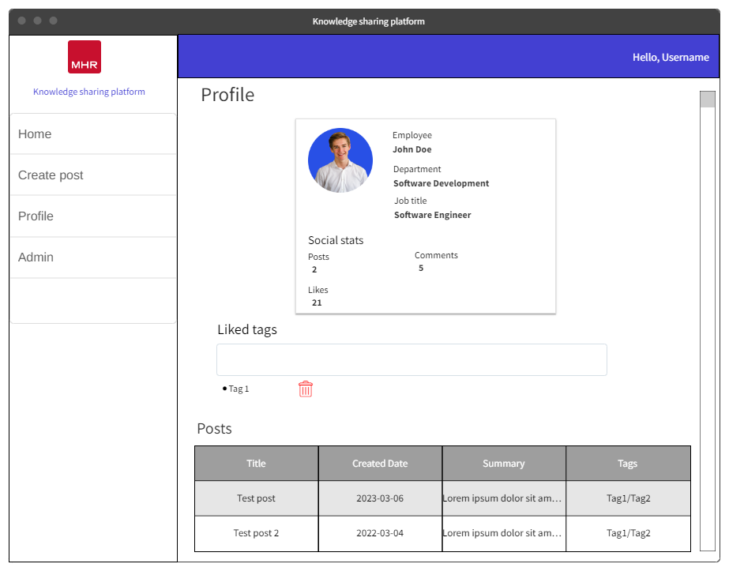
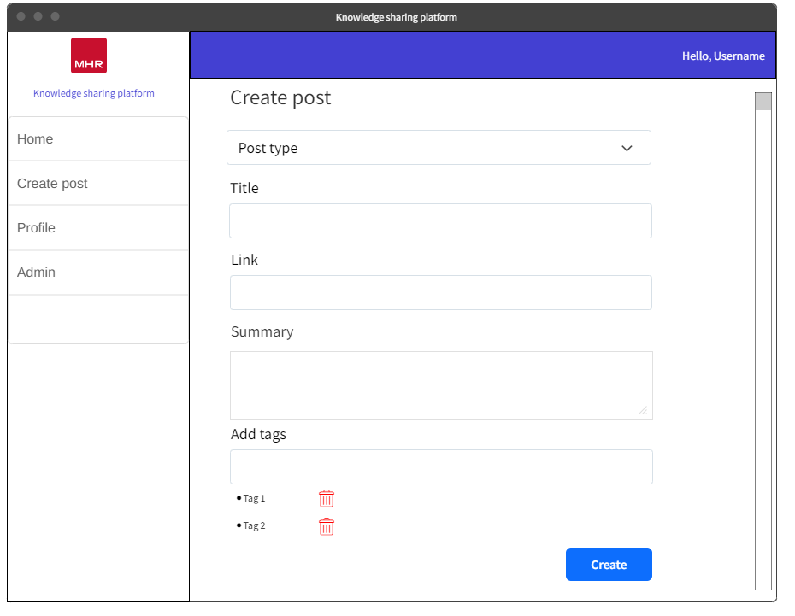
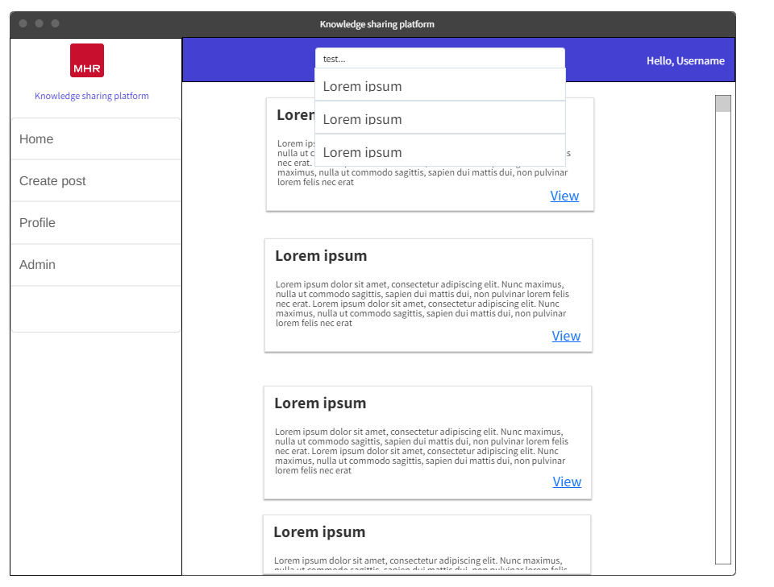
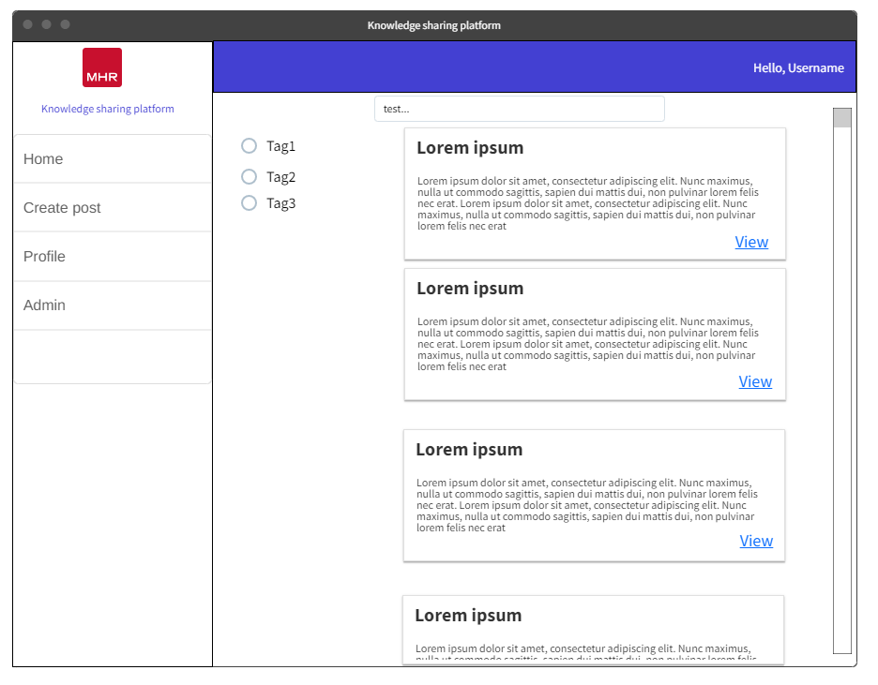
UX Designs
Wireframes were created for the UI.
These were then reviewed and had feedback from stakeholders in the project.

Slide 23

Iterative development
Break down of each sprint and what was done

Slide 24
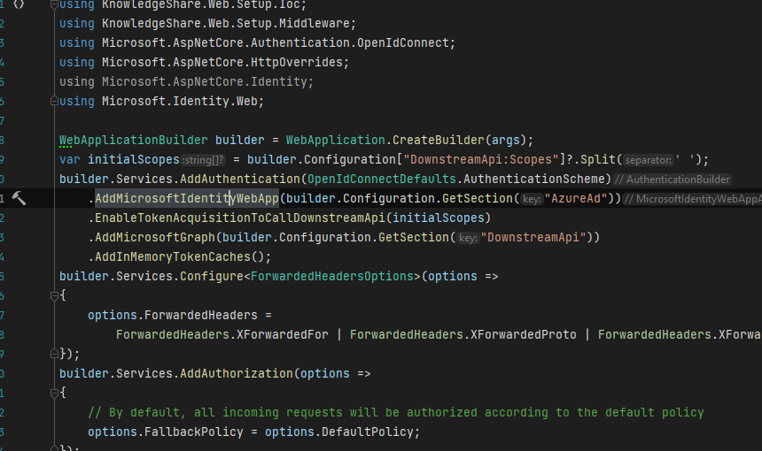
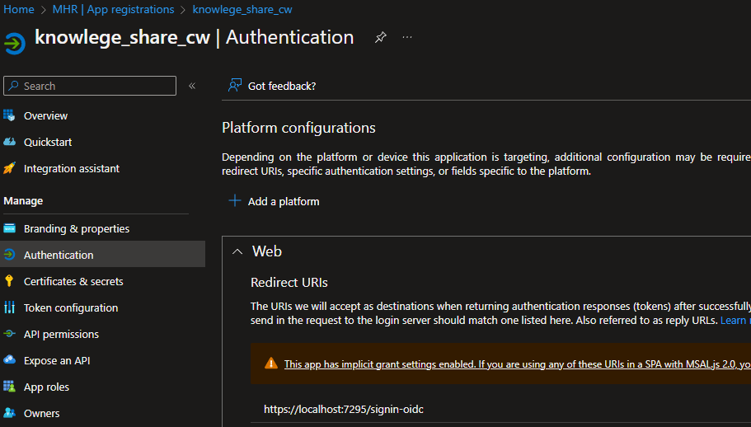
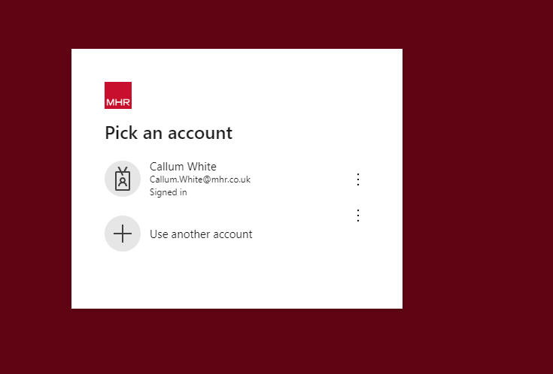
Sprint 1
Single sign on setup
Create app registration in Azure & provide the redirect URL
Setup authentication in .NET application startup project

Slide 25
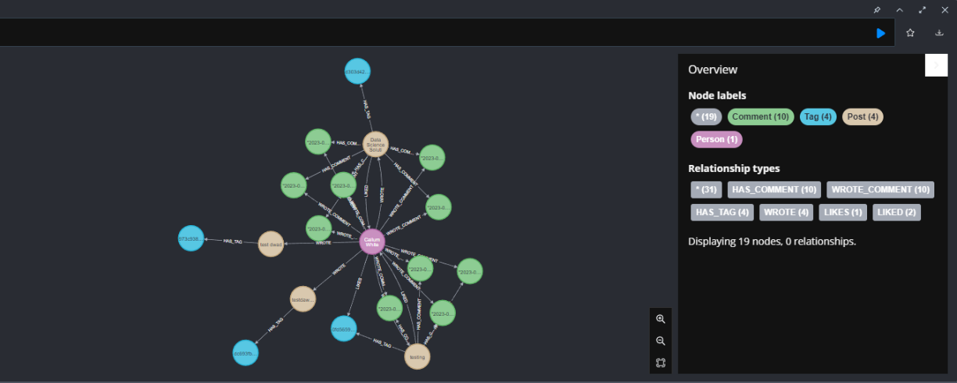
Sprint 1
The challenge in developing the graph database was configuring persistence layer for Neo4j. Setup involved installing Neo4j, establishing connection, and utilizing .NET driver.
Shows a graph of the data model within Neo4j database, this uses bloom that allows for queries to be directly ran on the database and shown visually
Notes:
The initial challenge in developing the graph database was configuring the application's persistence layer to interface with a Neo4j database. This involved installing Neo4j on the local machine and ensuring that the connection between the database and .NET application was properly established.
To set up the Neo4j driver in .NET, the team utilized NuGet to install the Neo4j .NET driver package to the .NET application. Additionally, they installed Neo4j Desktop to enable local database instance management and establish a connection to the database in their .NET application using the driver, specifying server address, port, and credentials.

Slide 26
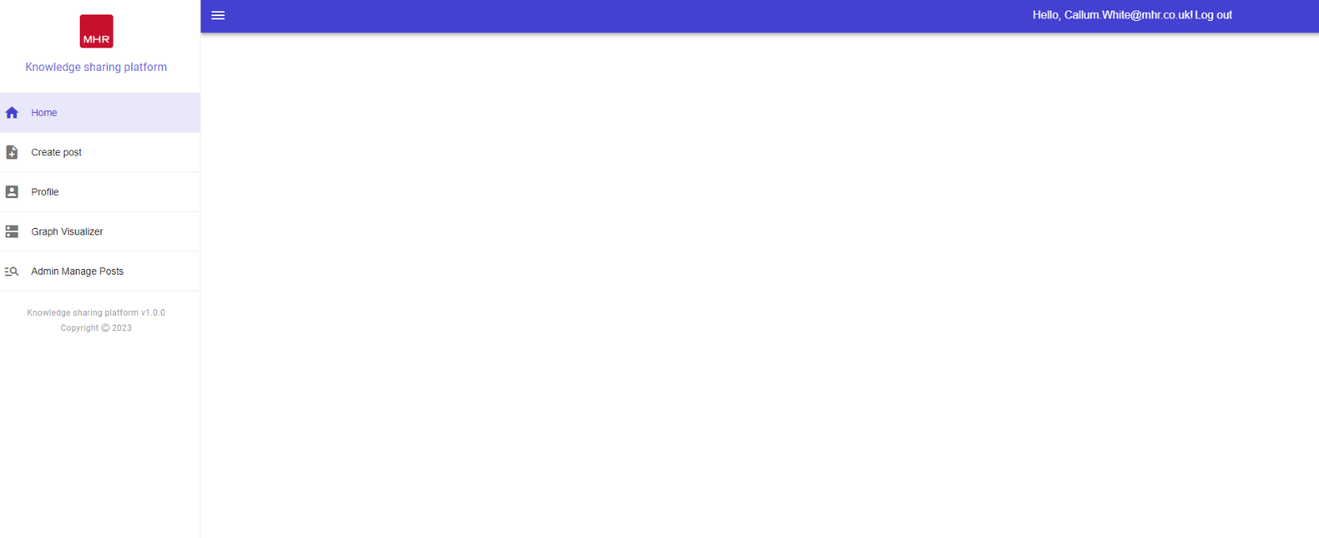
Sprint 2
Landing Page

Slide 27
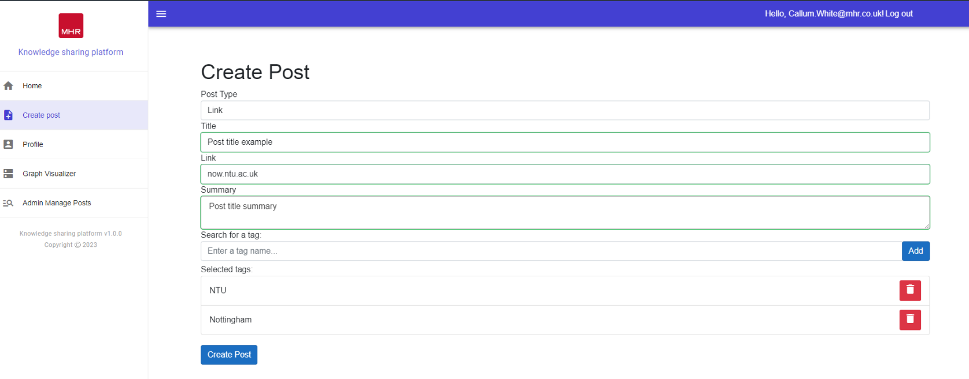
Sprint 2
Create post

Slide 28
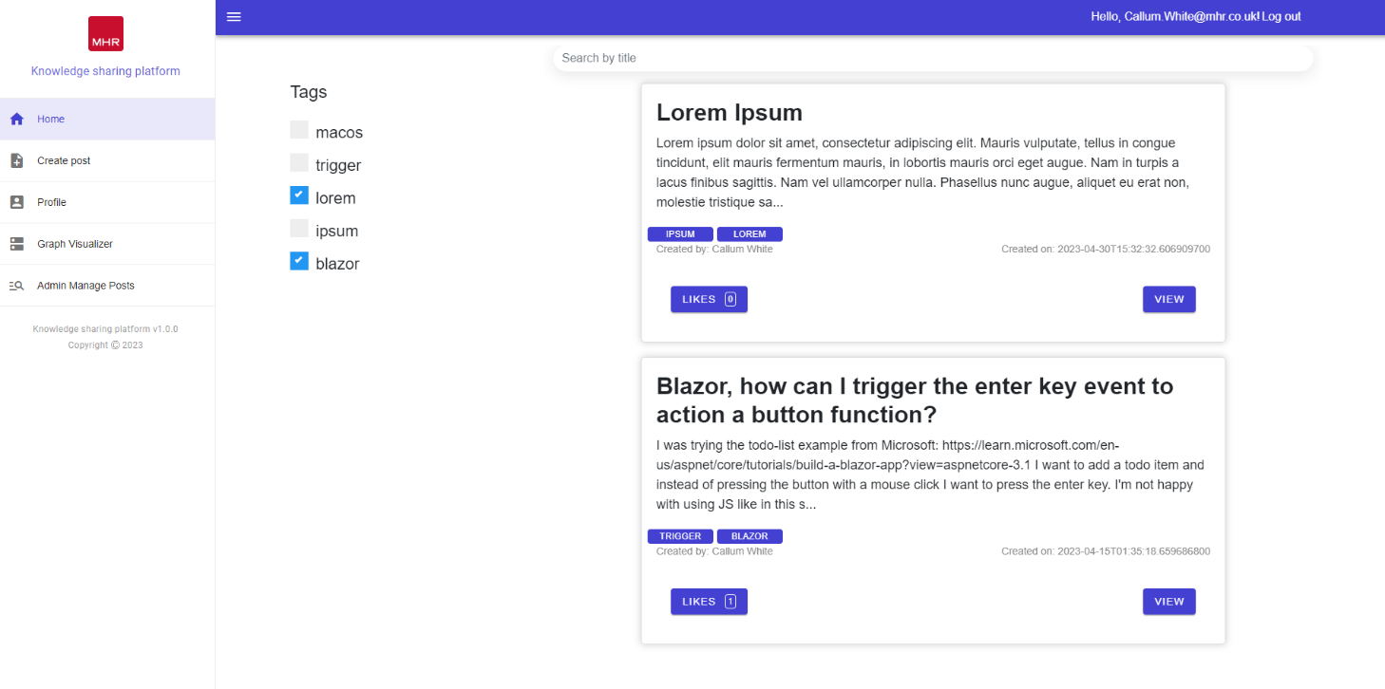
Sprint 2
Discovery

Slide 29
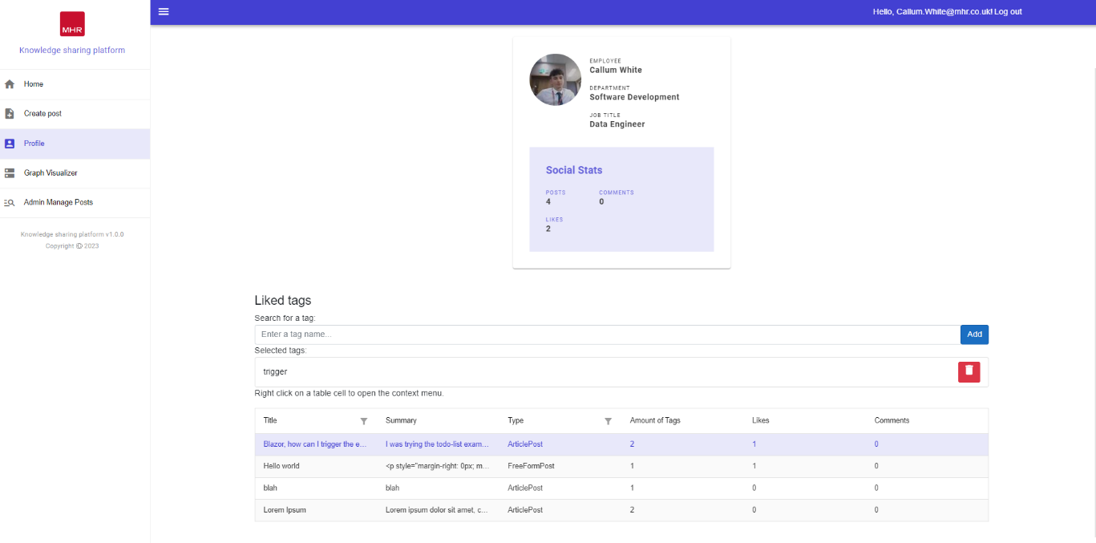
Sprint 3
Profile page

Slide 30
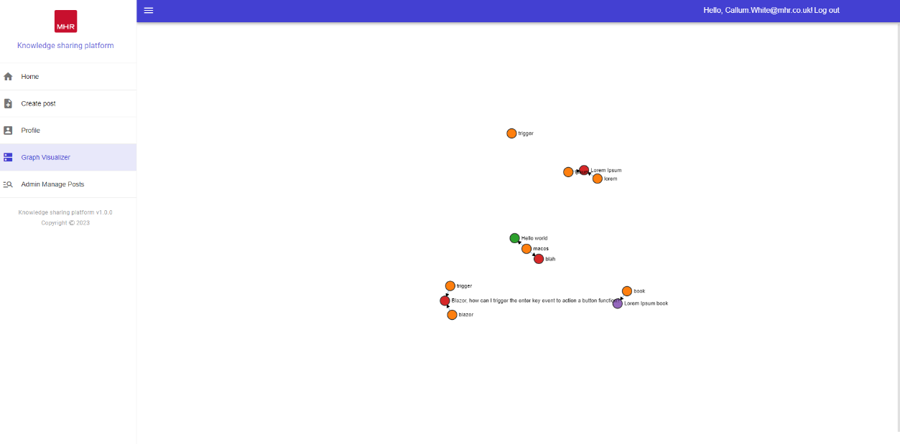
Sprint 3
Profile page

Slide 31
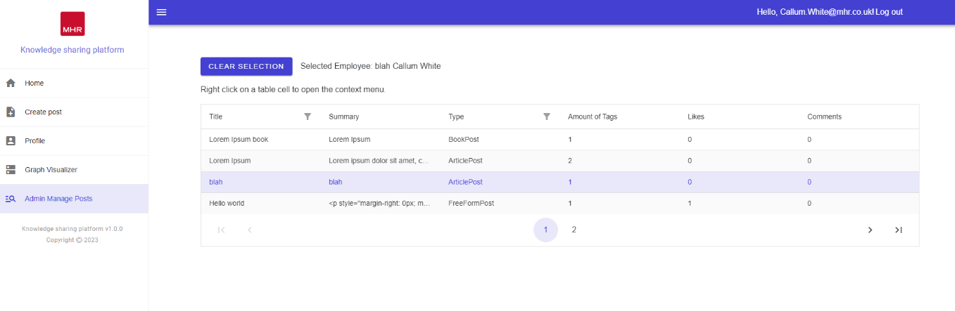
Sprint 3
Admin page

Slide 32
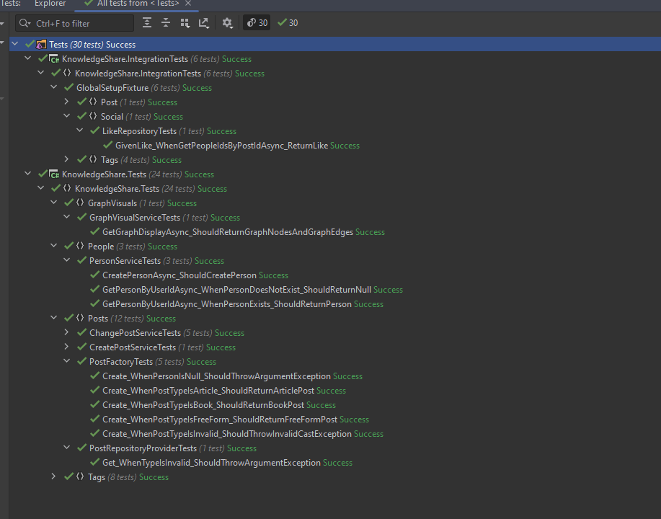
Unit testing

Slide 33
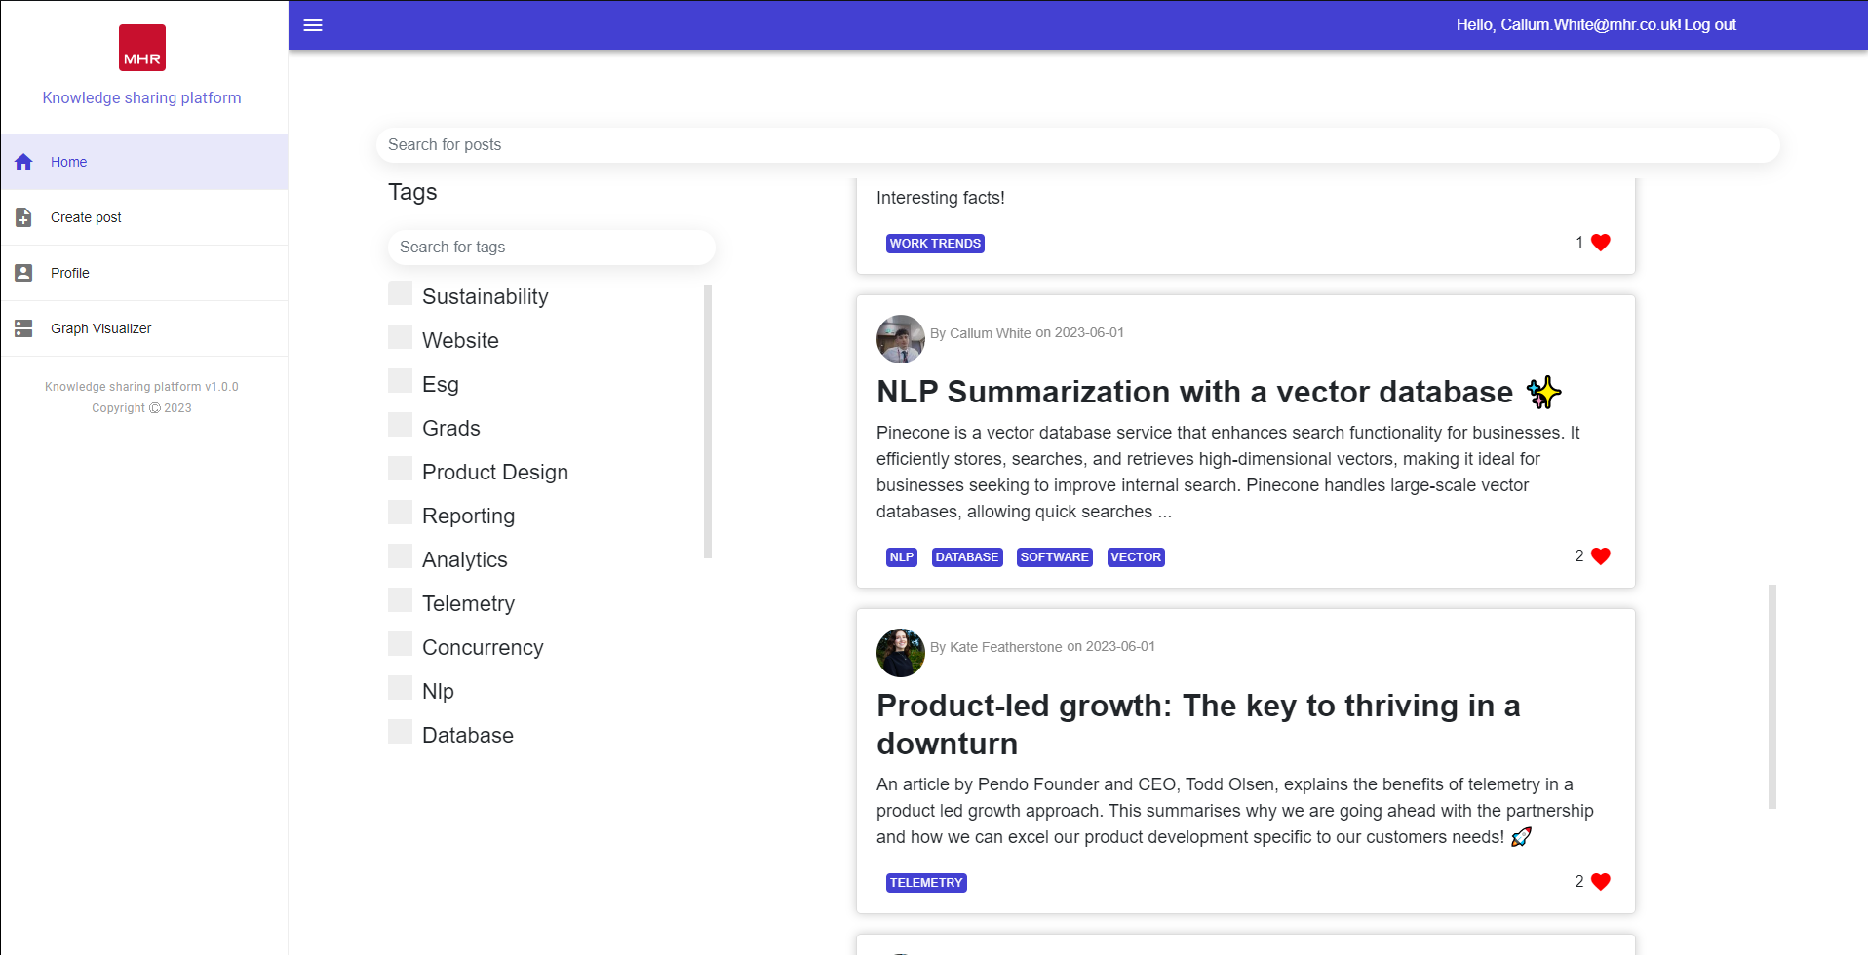
Live Demo of Knowledge sharing platform
Kate will be helping with the Demo

Slide 34
UI Feedback
User experience (UX) feedback must be incorporated into the knowledge sharing platform's iterative development process to improve the platform's usability and aesthetic appeal.
Notes:
User experience (UX) feedback must be incorporated into the knowledge sharing platform's iterative development process to improve the platform's usability and aesthetic appeal. In this review, a UX specialist within in the business offers insightful commentary on the platform's various pages' CSS styling. Their suggestions centre on maximising screen space, achieving visual harmony, upholding consistency, and enhancing user experience overall.

Slide 35
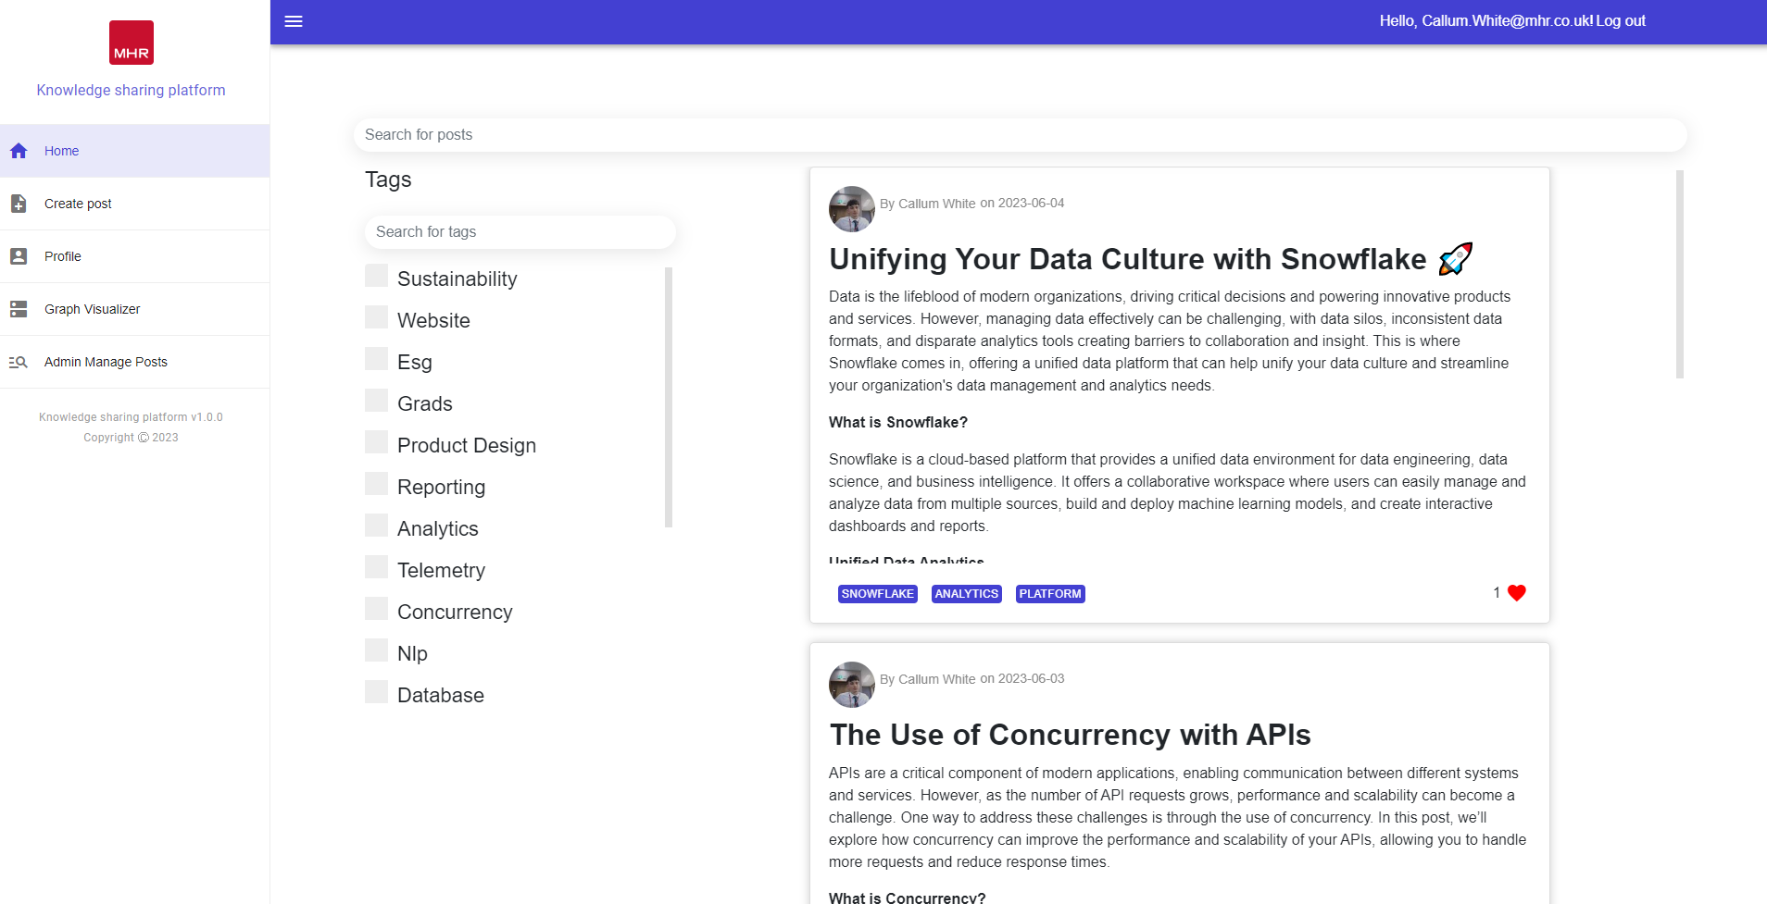
Discovery page
Notes:
Padding Reduction at the Bottom of Cards: To optimize screen real estate and achieve a more visually balanced layout, it is recommended to decrease the padding between the content of the cards and the bottom edge. This adjustment will create a more compact design while maintaining the necessary breathing space.
Background Removal and Lowercasing of "Likes": To maintain a consistent and modern typographic style, our UX expert suggests removing any background element behind the likes count on the cards. Additionally, they recommend using lowercase letters for the word "likes." These changes will contribute to a cleaner and more streamlined appearance.
Alignment of Likes with Info Detail: To enhance the visual hierarchy and overall alignment, aligning the likes count with the accompanying information details on the cards is advised. This adjustment will result in a more organized and visually pleasing layout, improving the overall user experience.
Removal of "View" Button for Post Access: To simplify the user interface and streamline the navigation, our UX expert proposes removing the "View" button that allows users to access the full post from the discovery page. Instead, it is suggested to make the entire card clickable, enabling users to navigate to the post by clicking anywhere on the card.
Use of Light Grey Colours for Tags: For an aesthetically pleasing design and reduced visual distractions, our colleague suggests utilizing light grey colours for the tags on the discovery page, replacing the current blue. This adjustment will create a more subdued and harmonious colour palette, allowing the primary content to stand out effectively.

Slide 36
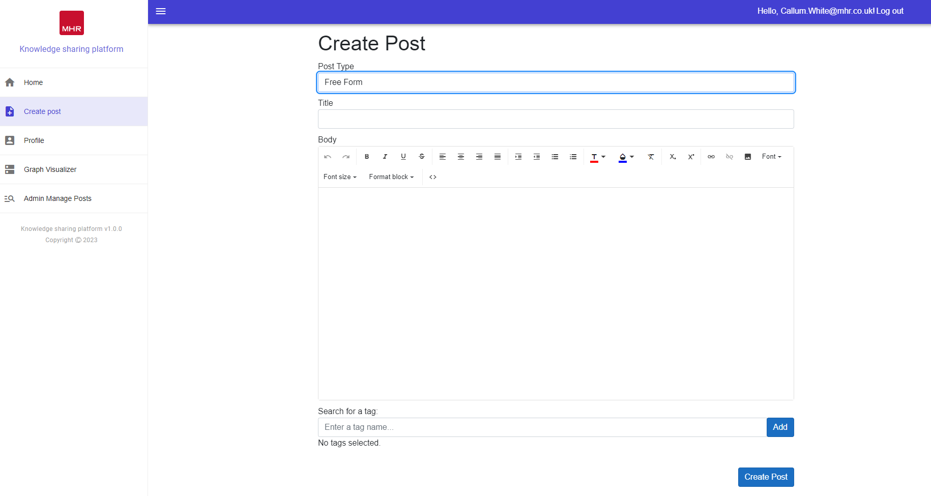
Create post page
Notes:
Padding Reduction at the Bottom of Cards: To optimize screen real estate and achieve a more visually balanced layout, it is recommended to decrease the padding between the content of the cards and the bottom edge. This adjustment will create a more compact design while maintaining the necessary breathing space.
Background Removal and Lowercasing of "Likes": To maintain a consistent and modern typographic style, our UX expert suggests removing any background element behind the likes count on the cards. Additionally, they recommend using lowercase letters for the word "likes." These changes will contribute to a cleaner and more streamlined appearance.
Alignment of Likes with Info Detail: To enhance the visual hierarchy and overall alignment, aligning the likes count with the accompanying information details on the cards is advised. This adjustment will result in a more organized and visually pleasing layout, improving the overall user experience.
Removal of "View" Button for Post Access: To simplify the user interface and streamline the navigation, our UX expert proposes removing the "View" button that allows users to access the full post from the discovery page. Instead, it is suggested to make the entire card clickable, enabling users to navigate to the post by clicking anywhere on the card.
Use of Light Grey Colours for Tags: For an aesthetically pleasing design and reduced visual distractions, our colleague suggests utilizing light grey colours for the tags on the discovery page, replacing the current blue. This adjustment will create a more subdued and harmonious colour palette, allowing the primary content to stand out effectively.

Slide 37
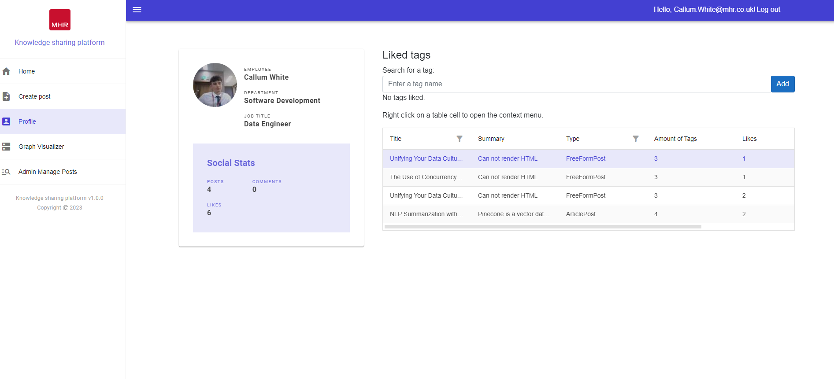
Profile page
Notes:
Padding Reduction at the Bottom of Cards: To optimize screen real estate and achieve a more visually balanced layout, it is recommended to decrease the padding between the content of the cards and the bottom edge. This adjustment will create a more compact design while maintaining the necessary breathing space.
Background Removal and Lowercasing of "Likes": To maintain a consistent and modern typographic style, our UX expert suggests removing any background element behind the likes count on the cards. Additionally, they recommend using lowercase letters for the word "likes." These changes will contribute to a cleaner and more streamlined appearance.
Alignment of Likes with Info Detail: To enhance the visual hierarchy and overall alignment, aligning the likes count with the accompanying information details on the cards is advised. This adjustment will result in a more organized and visually pleasing layout, improving the overall user experience.
Removal of "View" Button for Post Access: To simplify the user interface and streamline the navigation, our UX expert proposes removing the "View" button that allows users to access the full post from the discovery page. Instead, it is suggested to make the entire card clickable, enabling users to navigate to the post by clicking anywhere on the card.
Use of Light Grey Colours for Tags: For an aesthetically pleasing design and reduced visual distractions, our colleague suggests utilizing light grey colours for the tags on the discovery page, replacing the current blue. This adjustment will create a more subdued and harmonious colour palette, allowing the primary content to stand out effectively.

Slide 38
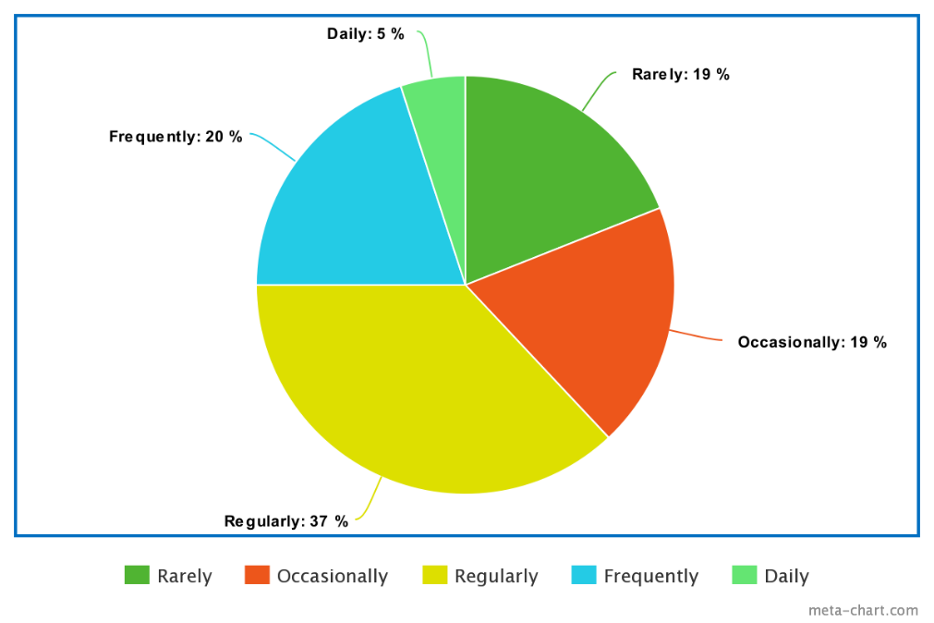
How frequently have you been using the platform?
Notes:
Padding Reduction at the Bottom of Cards: To optimize screen real estate and achieve a more visually balanced layout, it is recommended to decrease the padding between the content of the cards and the bottom edge. This adjustment will create a more compact design while maintaining the necessary breathing space.
Background Removal and Lowercasing of "Likes": To maintain a consistent and modern typographic style, our UX expert suggests removing any background element behind the likes count on the cards. Additionally, they recommend using lowercase letters for the word "likes." These changes will contribute to a cleaner and more streamlined appearance.
Alignment of Likes with Info Detail: To enhance the visual hierarchy and overall alignment, aligning the likes count with the accompanying information details on the cards is advised. This adjustment will result in a more organized and visually pleasing layout, improving the overall user experience.
Removal of "View" Button for Post Access: To simplify the user interface and streamline the navigation, our UX expert proposes removing the "View" button that allows users to access the full post from the discovery page. Instead, it is suggested to make the entire card clickable, enabling users to navigate to the post by clicking anywhere on the card.
Use of Light Grey Colours for Tags: For an aesthetically pleasing design and reduced visual distractions, our colleague suggests utilizing light grey colours for the tags on the discovery page, replacing the current blue. This adjustment will create a more subdued and harmonious colour palette, allowing the primary content to stand out effectively.

Slide 39
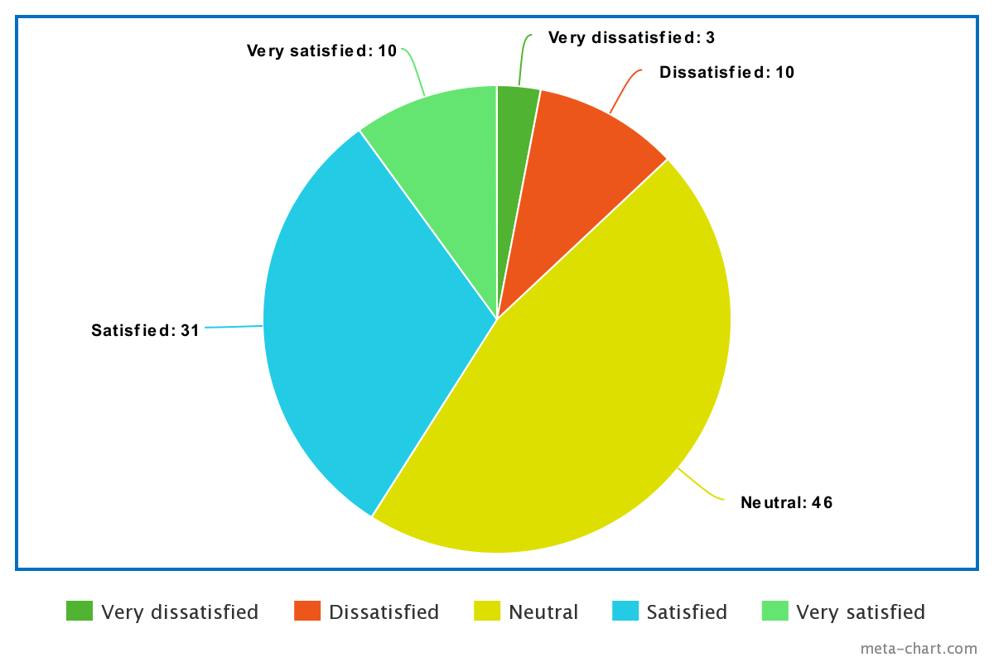
How satisfied are you with the user interface and overall experience?
Notes:
Padding Reduction at the Bottom of Cards: To optimize screen real estate and achieve a more visually balanced layout, it is recommended to decrease the padding between the content of the cards and the bottom edge. This adjustment will create a more compact design while maintaining the necessary breathing space.
Background Removal and Lowercasing of "Likes": To maintain a consistent and modern typographic style, our UX expert suggests removing any background element behind the likes count on the cards. Additionally, they recommend using lowercase letters for the word "likes." These changes will contribute to a cleaner and more streamlined appearance.
Alignment of Likes with Info Detail: To enhance the visual hierarchy and overall alignment, aligning the likes count with the accompanying information details on the cards is advised. This adjustment will result in a more organized and visually pleasing layout, improving the overall user experience.
Removal of "View" Button for Post Access: To simplify the user interface and streamline the navigation, our UX expert proposes removing the "View" button that allows users to access the full post from the discovery page. Instead, it is suggested to make the entire card clickable, enabling users to navigate to the post by clicking anywhere on the card.
Use of Light Grey Colours for Tags: For an aesthetically pleasing design and reduced visual distractions, our colleague suggests utilizing light grey colours for the tags on the discovery page, replacing the current blue. This adjustment will create a more subdued and harmonious colour palette, allowing the primary content to stand out effectively.

Slide 40
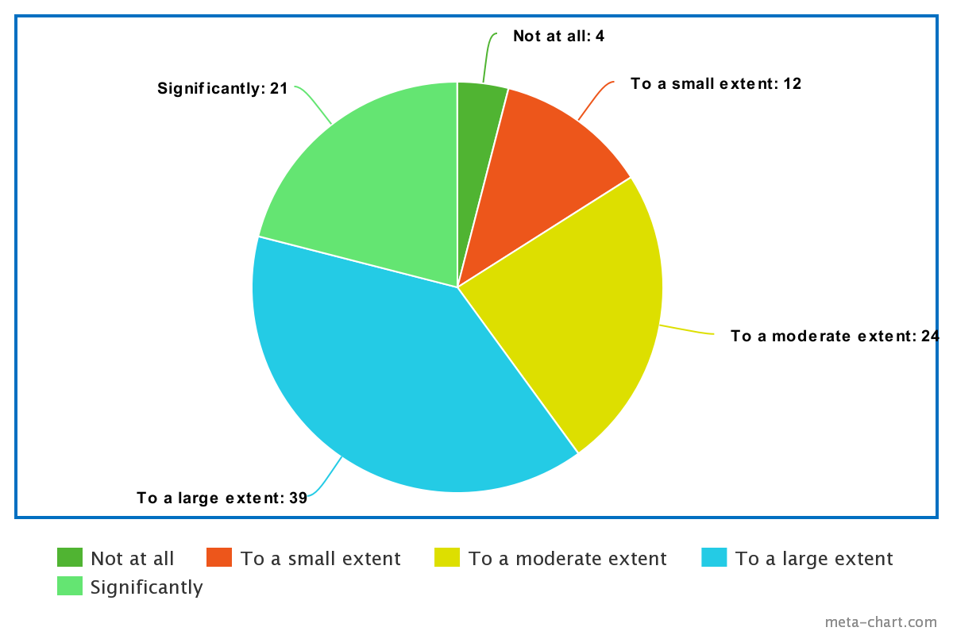
Is the platform useful for sharing your knowledge and expertise?
Notes:
Padding Reduction at the Bottom of Cards: To optimize screen real estate and achieve a more visually balanced layout, it is recommended to decrease the padding between the content of the cards and the bottom edge. This adjustment will create a more compact design while maintaining the necessary breathing space.
Background Removal and Lowercasing of "Likes": To maintain a consistent and modern typographic style, our UX expert suggests removing any background element behind the likes count on the cards. Additionally, they recommend using lowercase letters for the word "likes." These changes will contribute to a cleaner and more streamlined appearance.
Alignment of Likes with Info Detail: To enhance the visual hierarchy and overall alignment, aligning the likes count with the accompanying information details on the cards is advised. This adjustment will result in a more organized and visually pleasing layout, improving the overall user experience.
Removal of "View" Button for Post Access: To simplify the user interface and streamline the navigation, our UX expert proposes removing the "View" button that allows users to access the full post from the discovery page. Instead, it is suggested to make the entire card clickable, enabling users to navigate to the post by clicking anywhere on the card.
Use of Light Grey Colours for Tags: For an aesthetically pleasing design and reduced visual distractions, our colleague suggests utilizing light grey colours for the tags on the discovery page, replacing the current blue. This adjustment will create a more subdued and harmonious colour palette, allowing the primary content to stand out effectively.

Slide 41
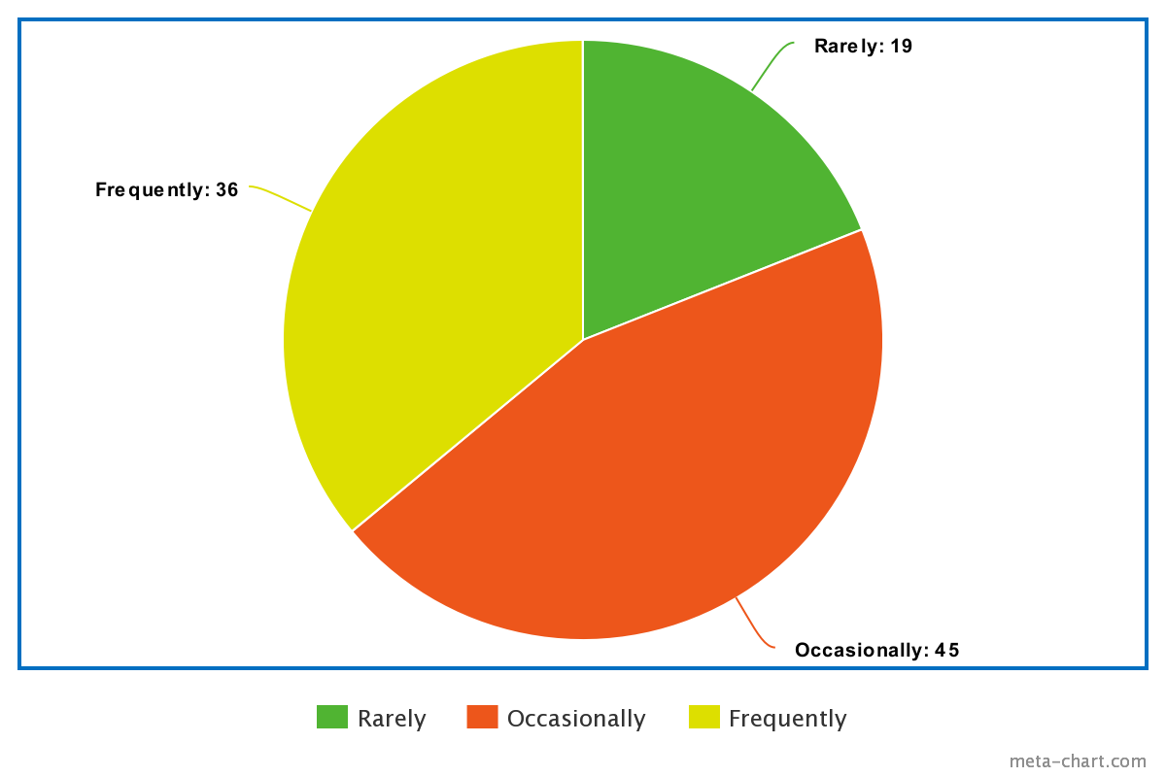
How often have you come across information shared by users from other departments?
Notes:
Padding Reduction at the Bottom of Cards: To optimize screen real estate and achieve a more visually balanced layout, it is recommended to decrease the padding between the content of the cards and the bottom edge. This adjustment will create a more compact design while maintaining the necessary breathing space.
Background Removal and Lowercasing of "Likes": To maintain a consistent and modern typographic style, our UX expert suggests removing any background element behind the likes count on the cards. Additionally, they recommend using lowercase letters for the word "likes." These changes will contribute to a cleaner and more streamlined appearance.
Alignment of Likes with Info Detail: To enhance the visual hierarchy and overall alignment, aligning the likes count with the accompanying information details on the cards is advised. This adjustment will result in a more organized and visually pleasing layout, improving the overall user experience.
Removal of "View" Button for Post Access: To simplify the user interface and streamline the navigation, our UX expert proposes removing the "View" button that allows users to access the full post from the discovery page. Instead, it is suggested to make the entire card clickable, enabling users to navigate to the post by clicking anywhere on the card.
Use of Light Grey Colours for Tags: For an aesthetically pleasing design and reduced visual distractions, our colleague suggests utilizing light grey colours for the tags on the discovery page, replacing the current blue. This adjustment will create a more subdued and harmonious colour palette, allowing the primary content to stand out effectively.

Slide 42
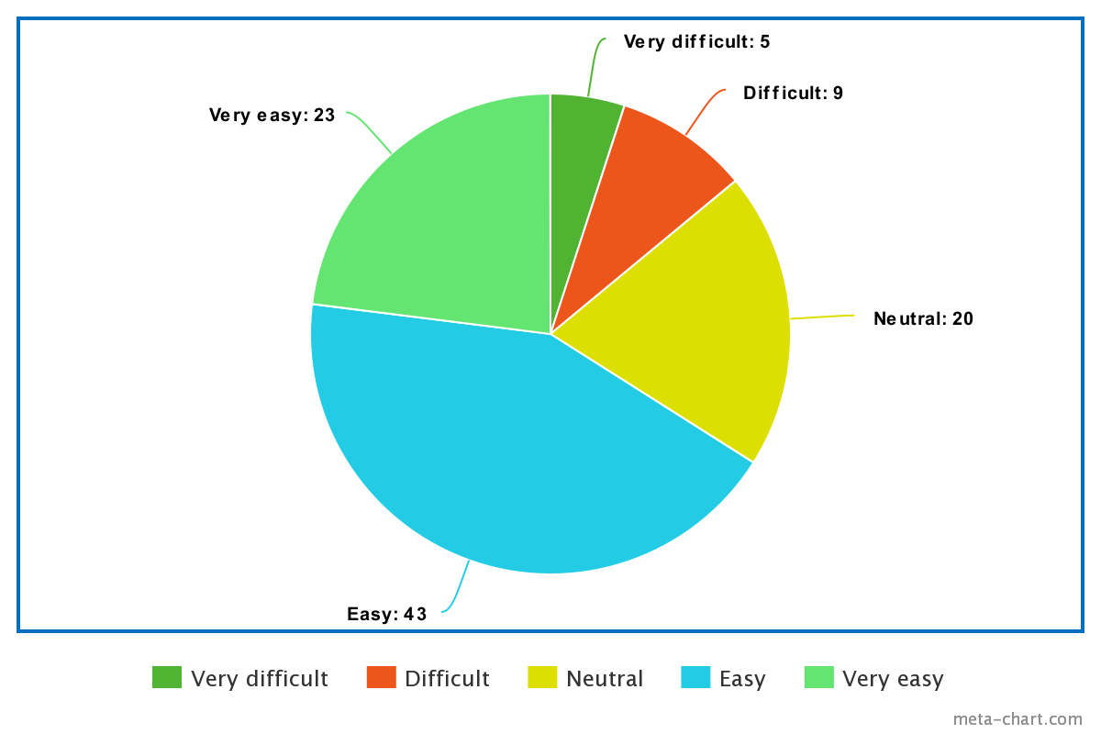
How easy is it to use the platform and create posts?
Notes:
Padding Reduction at the Bottom of Cards: To optimize screen real estate and achieve a more visually balanced layout, it is recommended to decrease the padding between the content of the cards and the bottom edge. This adjustment will create a more compact design while maintaining the necessary breathing space.
Background Removal and Lowercasing of "Likes": To maintain a consistent and modern typographic style, our UX expert suggests removing any background element behind the likes count on the cards. Additionally, they recommend using lowercase letters for the word "likes." These changes will contribute to a cleaner and more streamlined appearance.
Alignment of Likes with Info Detail: To enhance the visual hierarchy and overall alignment, aligning the likes count with the accompanying information details on the cards is advised. This adjustment will result in a more organized and visually pleasing layout, improving the overall user experience.
Removal of "View" Button for Post Access: To simplify the user interface and streamline the navigation, our UX expert proposes removing the "View" button that allows users to access the full post from the discovery page. Instead, it is suggested to make the entire card clickable, enabling users to navigate to the post by clicking anywhere on the card.
Use of Light Grey Colours for Tags: For an aesthetically pleasing design and reduced visual distractions, our colleague suggests utilizing light grey colours for the tags on the discovery page, replacing the current blue. This adjustment will create a more subdued and harmonious colour palette, allowing the primary content to stand out effectively.

Slide 43
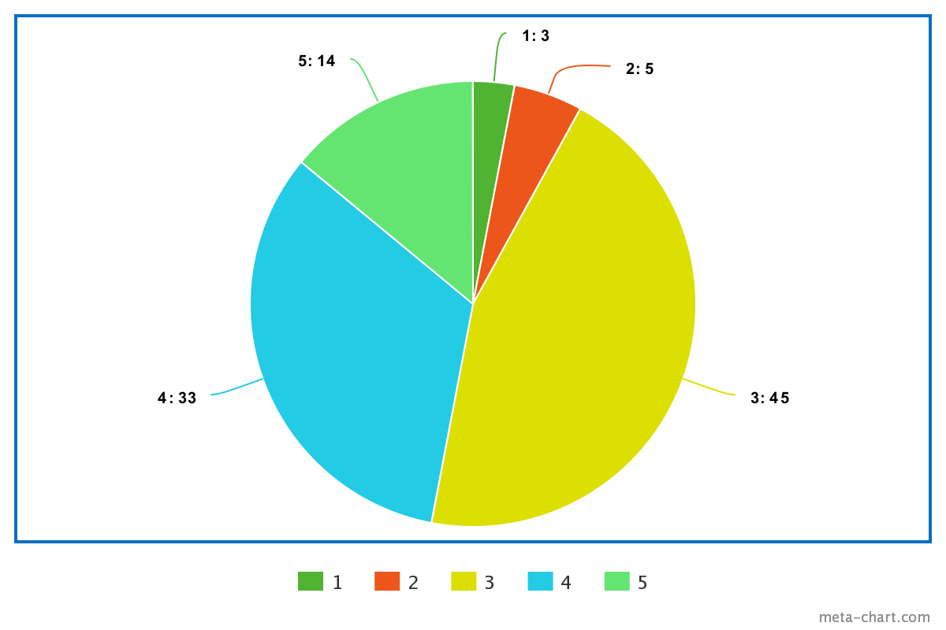
Overall Satisfaction On a scale of 1 to 5, where 1 is very dissatisfied and 5 is very satisfied
Notes:
Padding Reduction at the Bottom of Cards: To optimize screen real estate and achieve a more visually balanced layout, it is recommended to decrease the padding between the content of the cards and the bottom edge. This adjustment will create a more compact design while maintaining the necessary breathing space.
Background Removal and Lowercasing of "Likes": To maintain a consistent and modern typographic style, our UX expert suggests removing any background element behind the likes count on the cards. Additionally, they recommend using lowercase letters for the word "likes." These changes will contribute to a cleaner and more streamlined appearance.
Alignment of Likes with Info Detail: To enhance the visual hierarchy and overall alignment, aligning the likes count with the accompanying information details on the cards is advised. This adjustment will result in a more organized and visually pleasing layout, improving the overall user experience.
Removal of "View" Button for Post Access: To simplify the user interface and streamline the navigation, our UX expert proposes removing the "View" button that allows users to access the full post from the discovery page. Instead, it is suggested to make the entire card clickable, enabling users to navigate to the post by clicking anywhere on the card.
Use of Light Grey Colours for Tags: For an aesthetically pleasing design and reduced visual distractions, our colleague suggests utilizing light grey colours for the tags on the discovery page, replacing the current blue. This adjustment will create a more subdued and harmonious colour palette, allowing the primary content to stand out effectively.

Slide 44
Thank you

Slide 45
Q&A

